Slide 1
Generative AI
Knowledge Resources 2025

Slide 2
Foundations

Slide 3
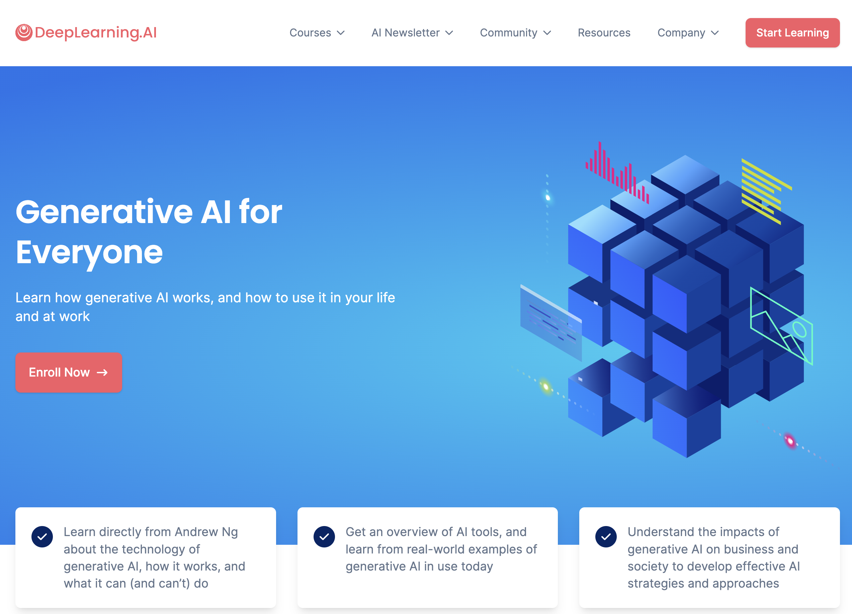
Deeplearning.ai
Free
3 h

Slide 4
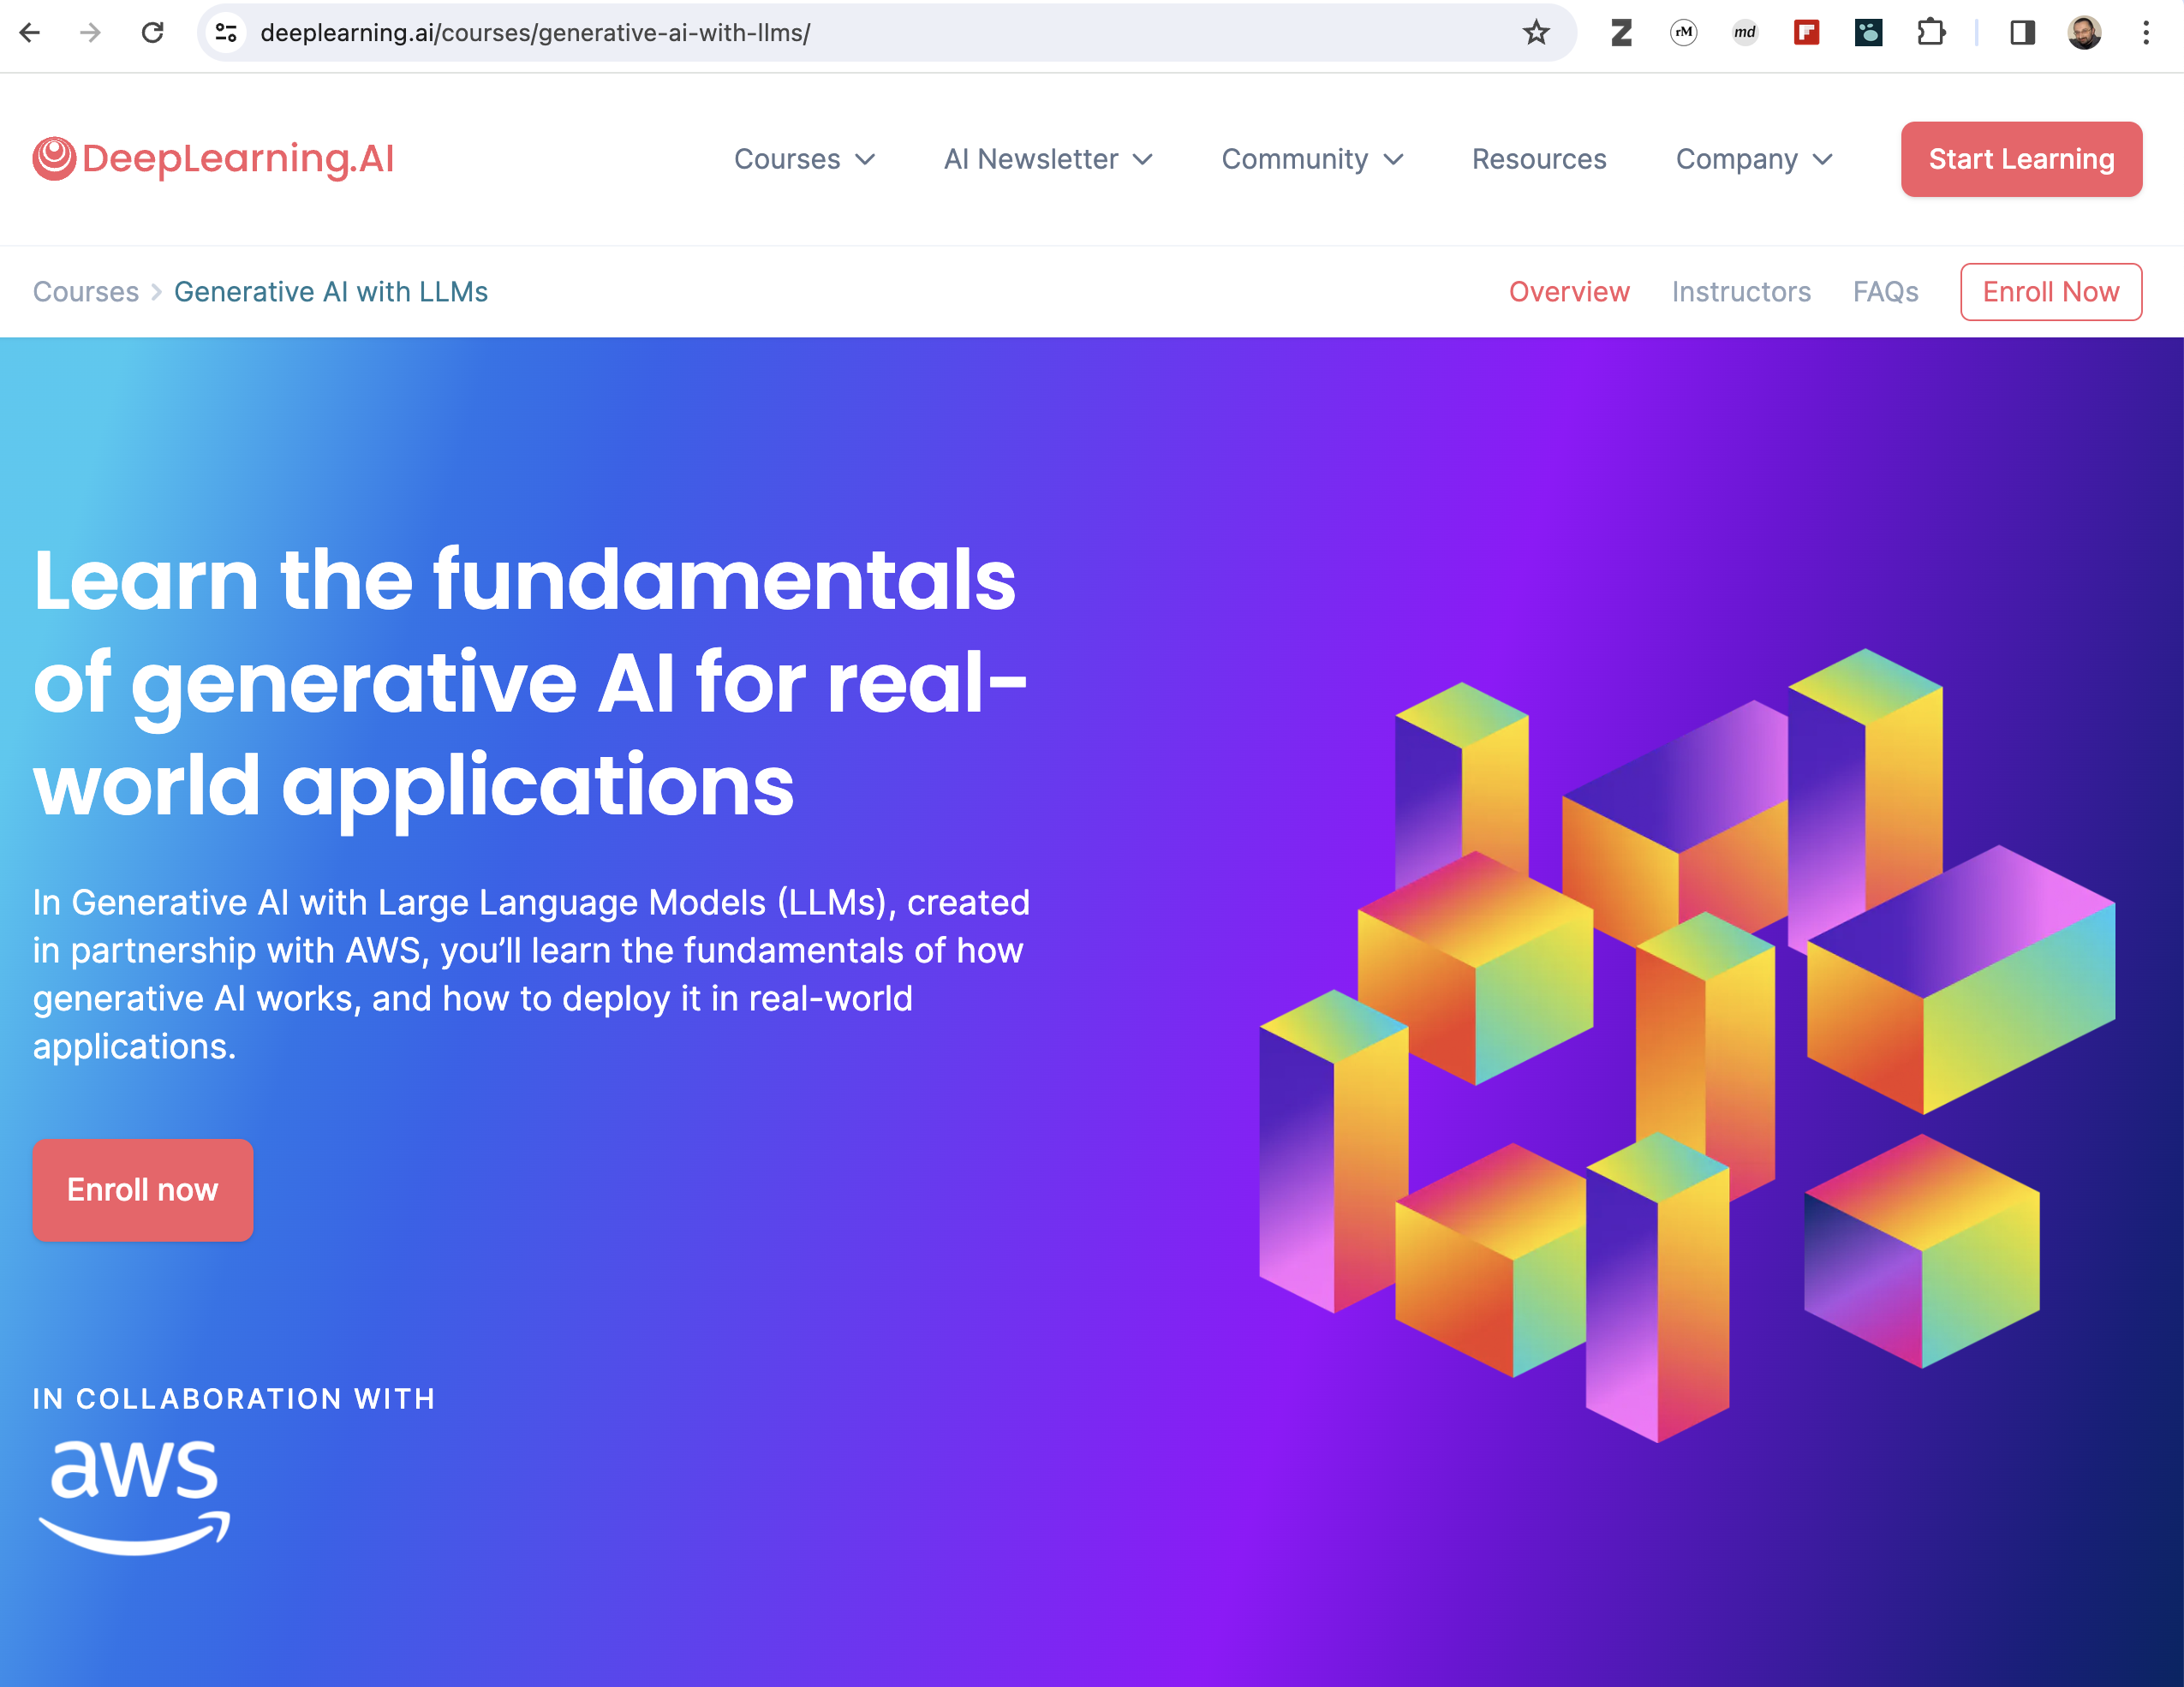
Deeplearning.ai
Free
3 h

Slide 5
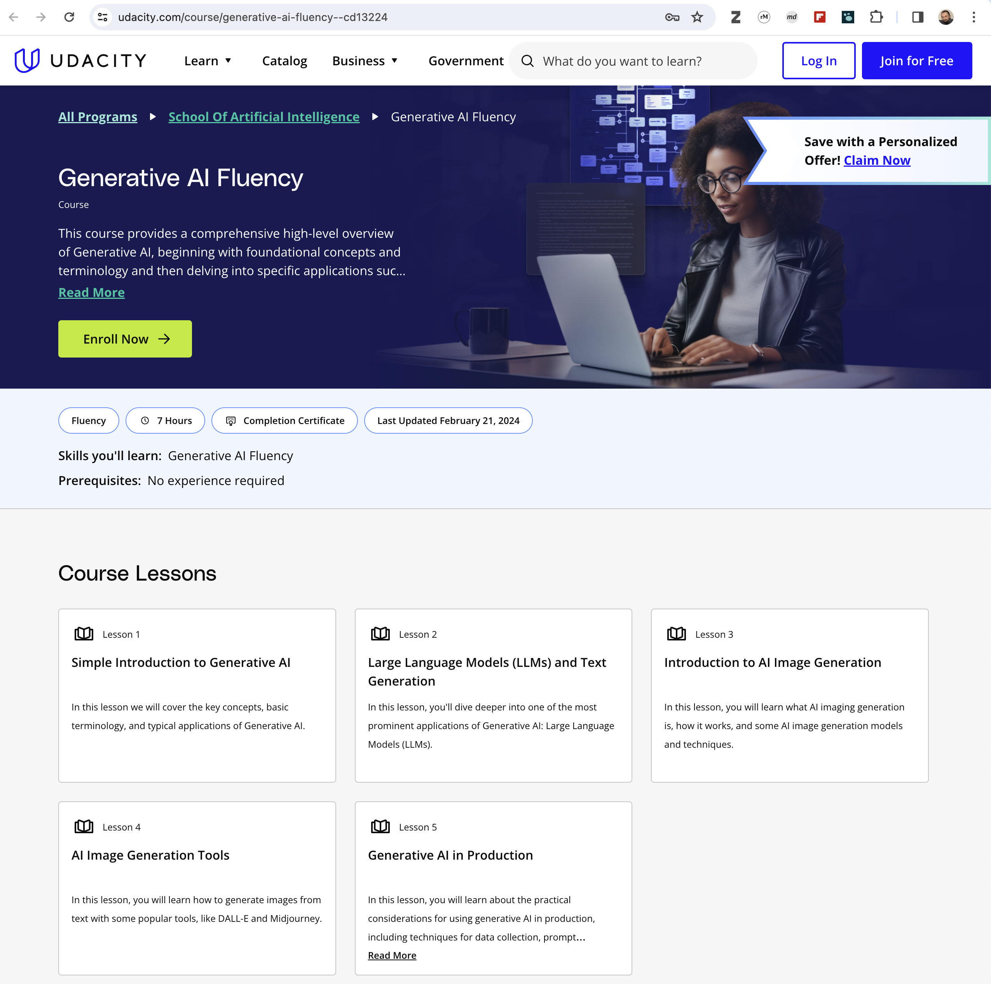
Udacity
Paid
7h

Slide 6

Udacity
Paid
4 Weeks

Slide 7
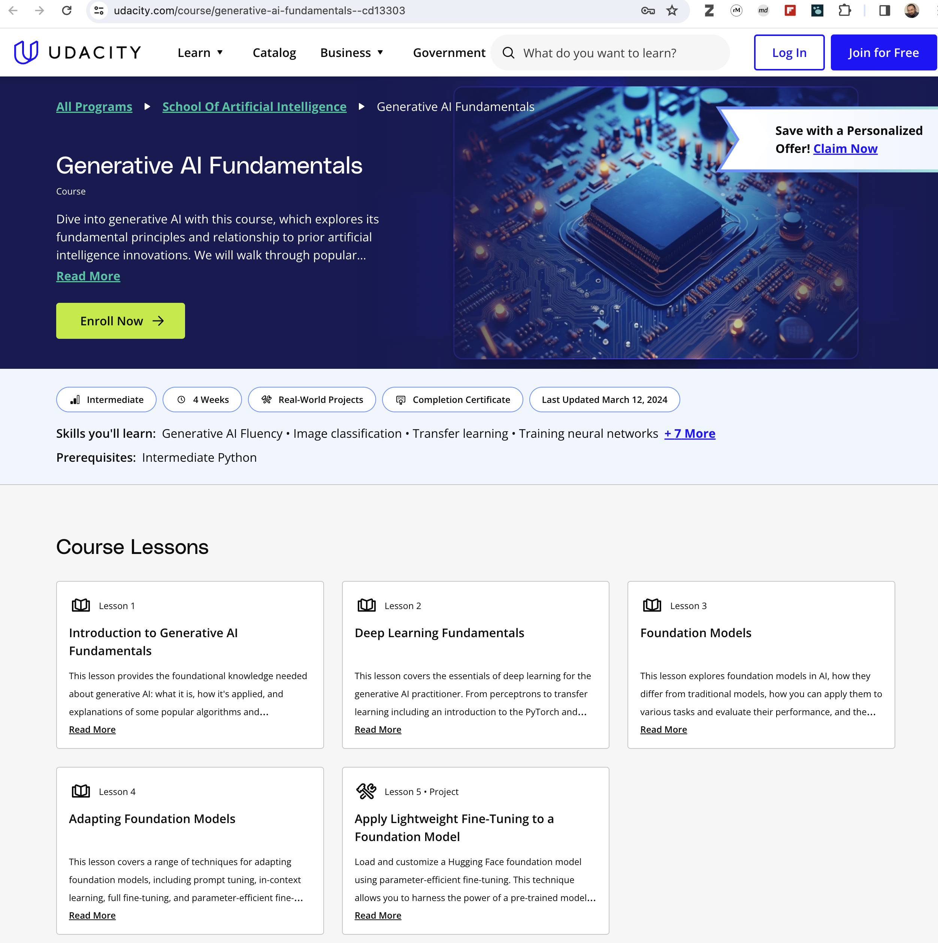
Udacity
Paid
4 Weeks

Slide 8
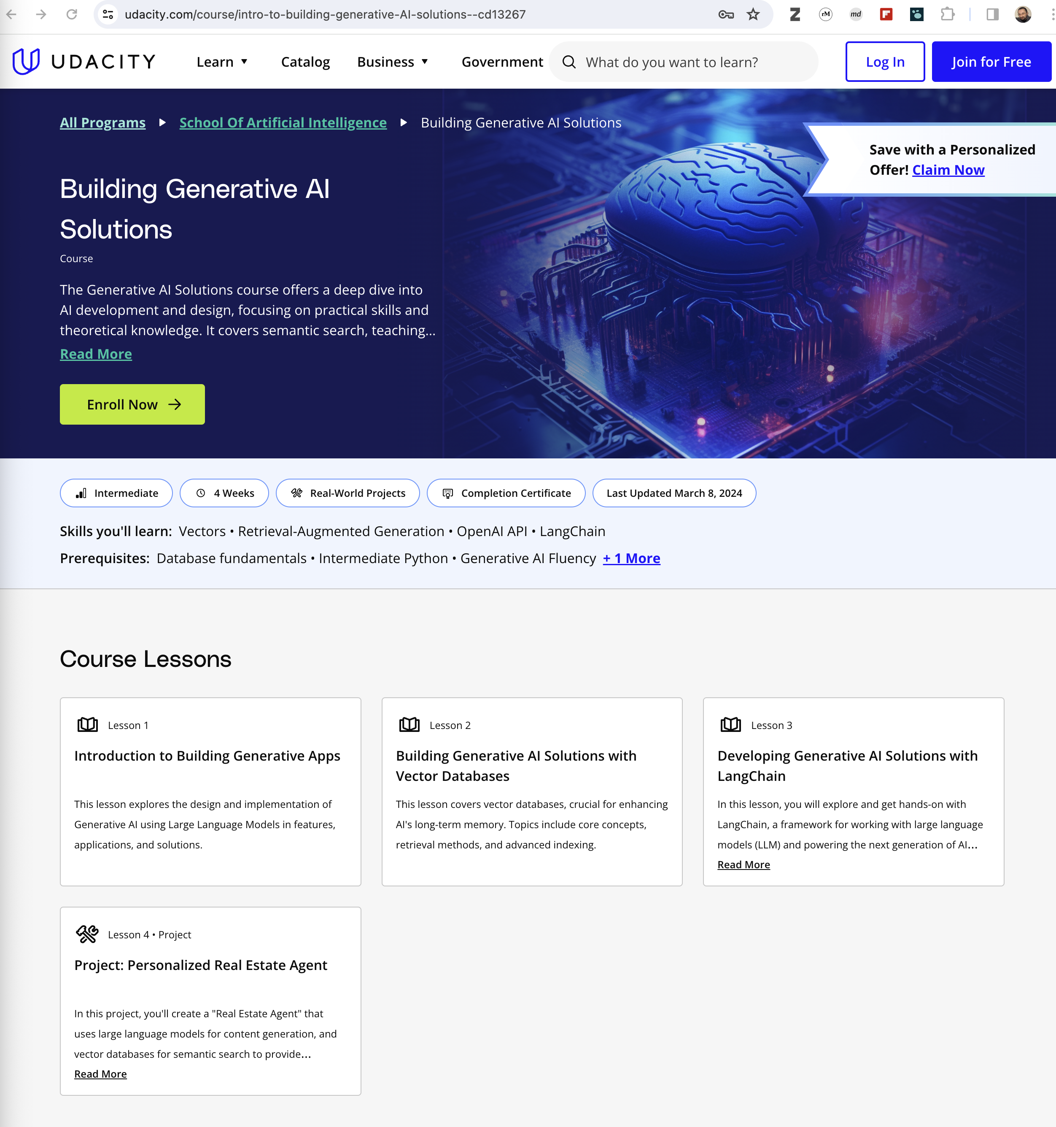
Udacity
Paid
4 Weeks

Slide 9
Technical

Slide 10
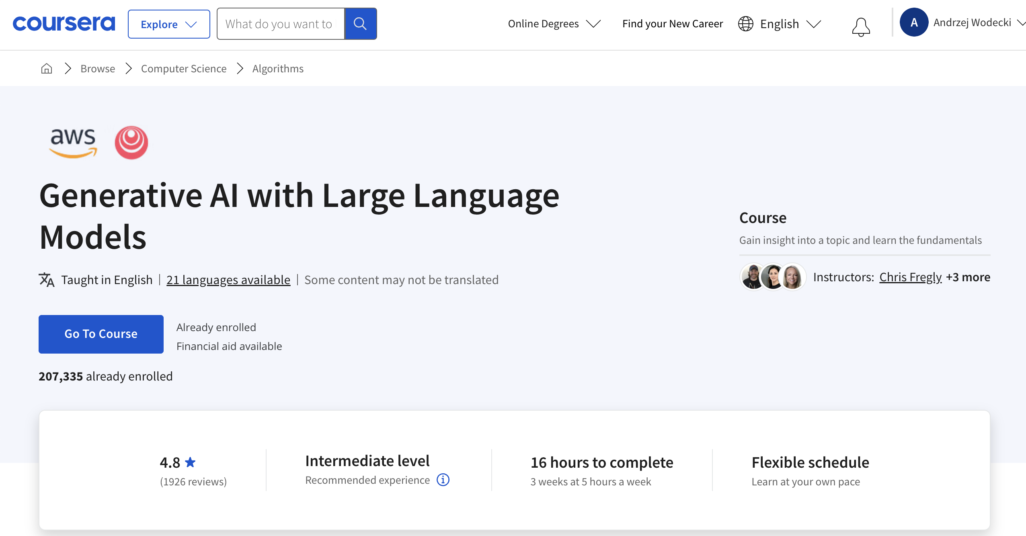
Coursera
Paid
3 Weeks

Slide 11
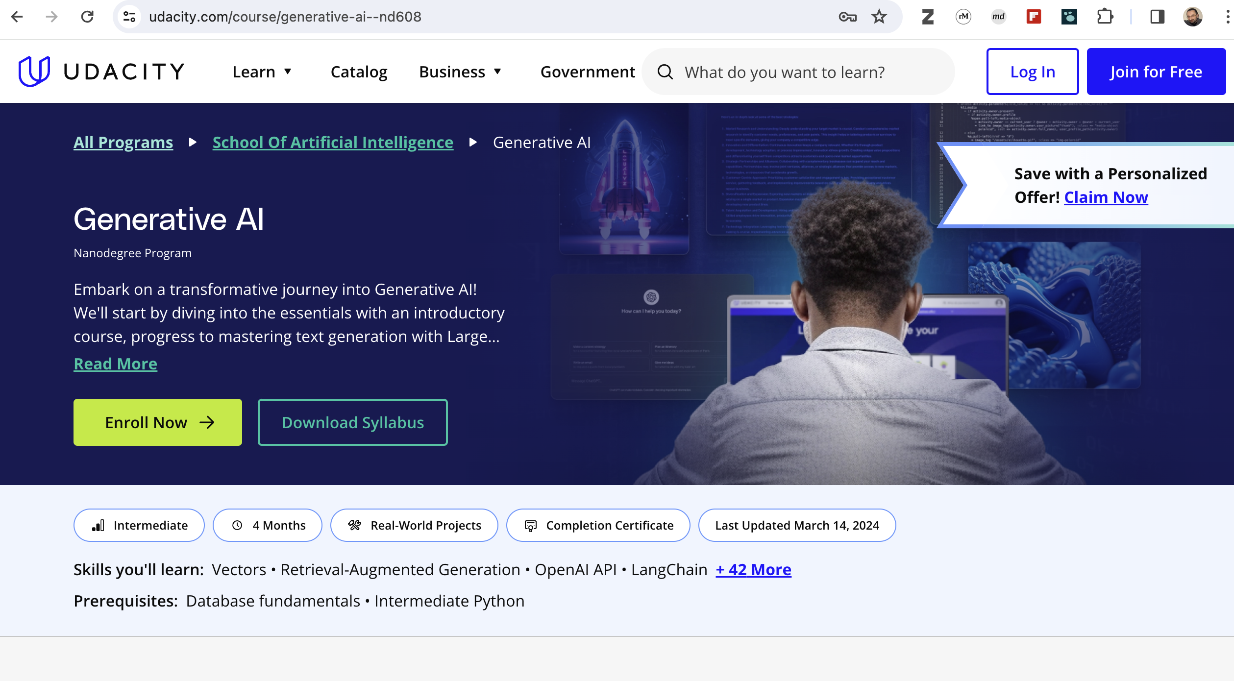
Udacity
Paid
4 months

Slide 12
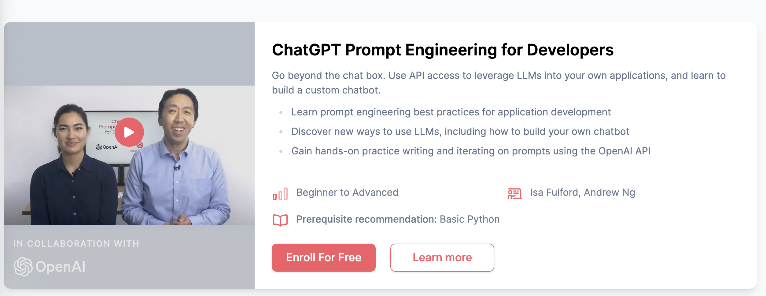
Deeplearning.ai
Free
6 h

Slide 13
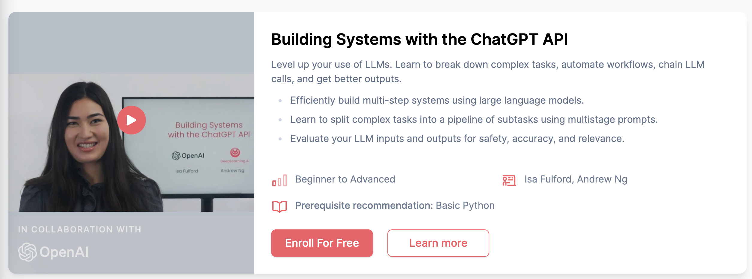
Deeplearning.ai
Free
6 h

Slide 14
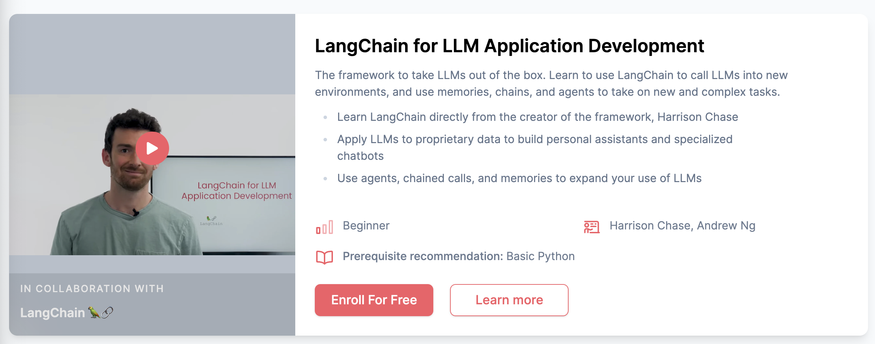
Deeplearning.ai
Free
6 h

Slide 15
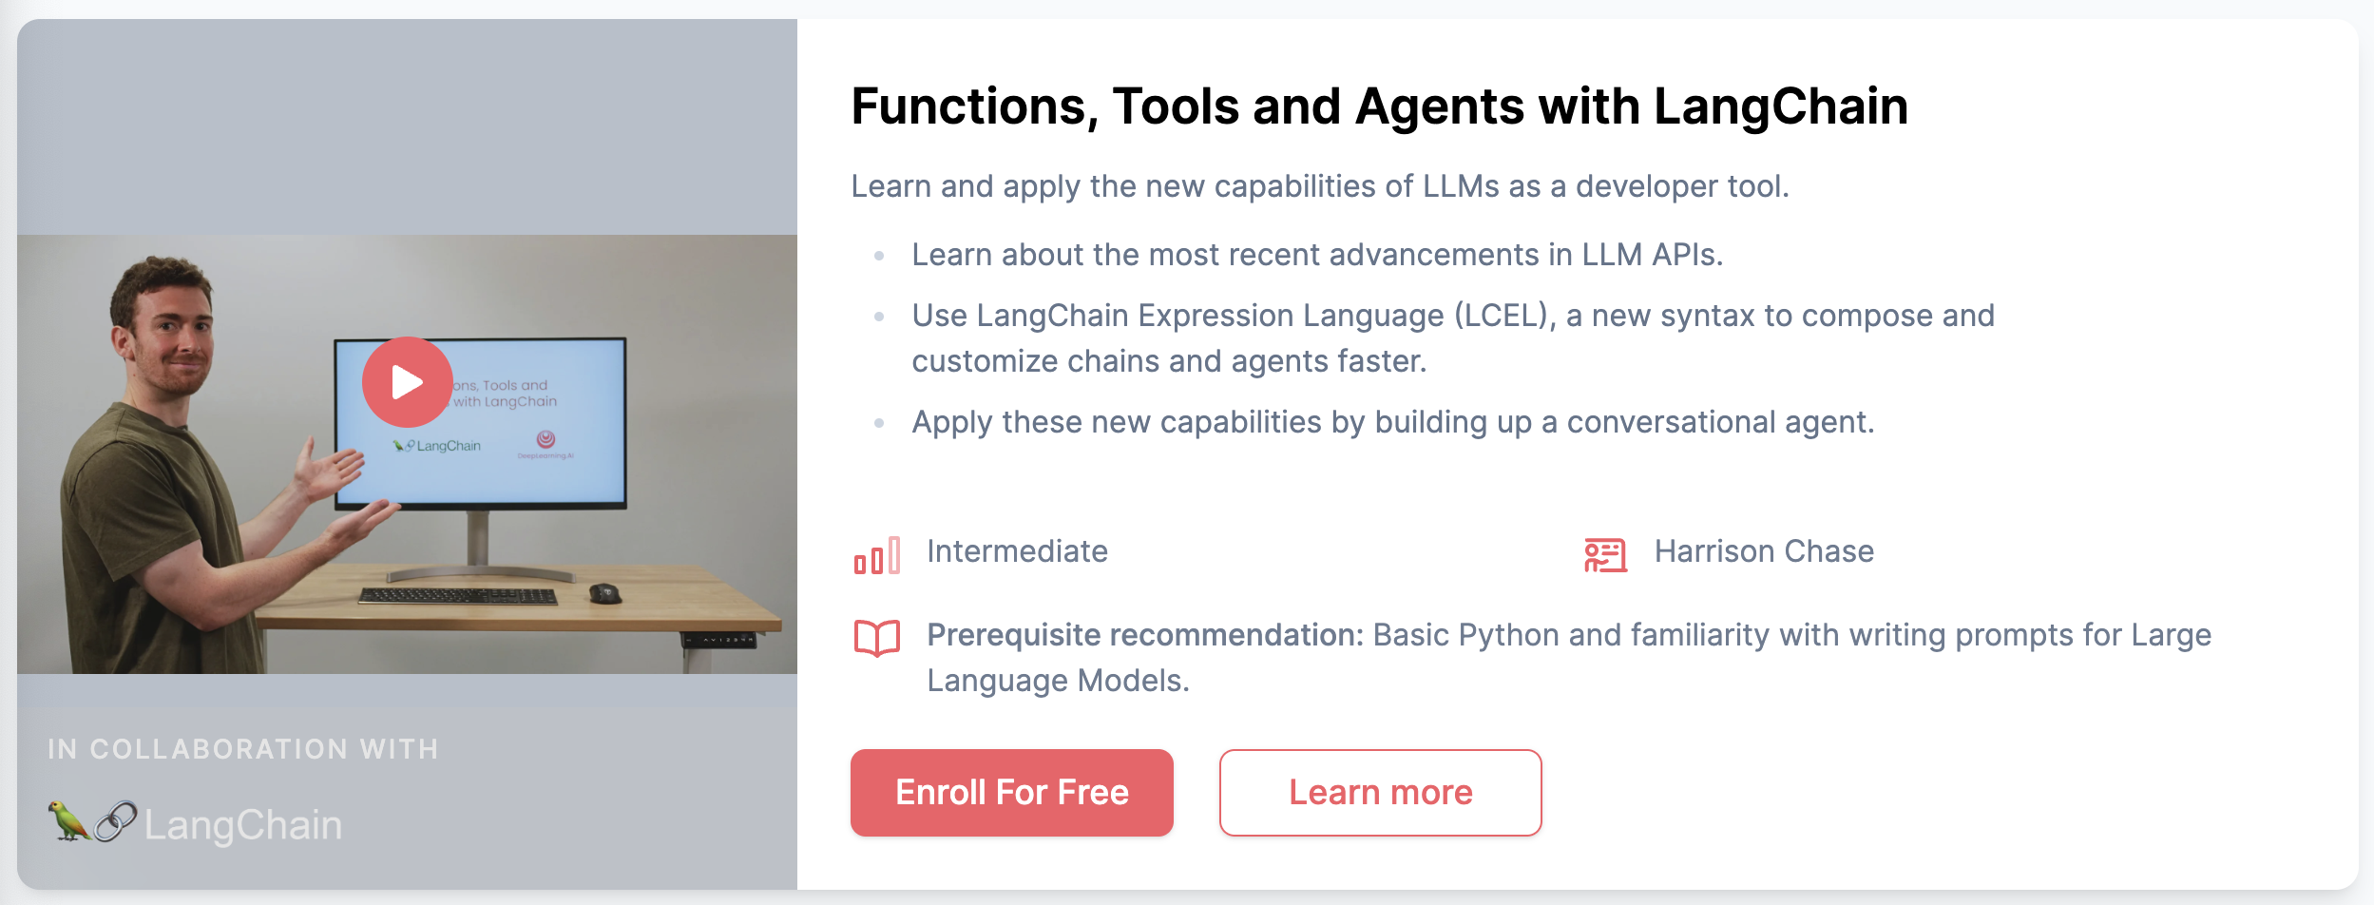
Deeplearning.ai
Free
6 h

Slide 16
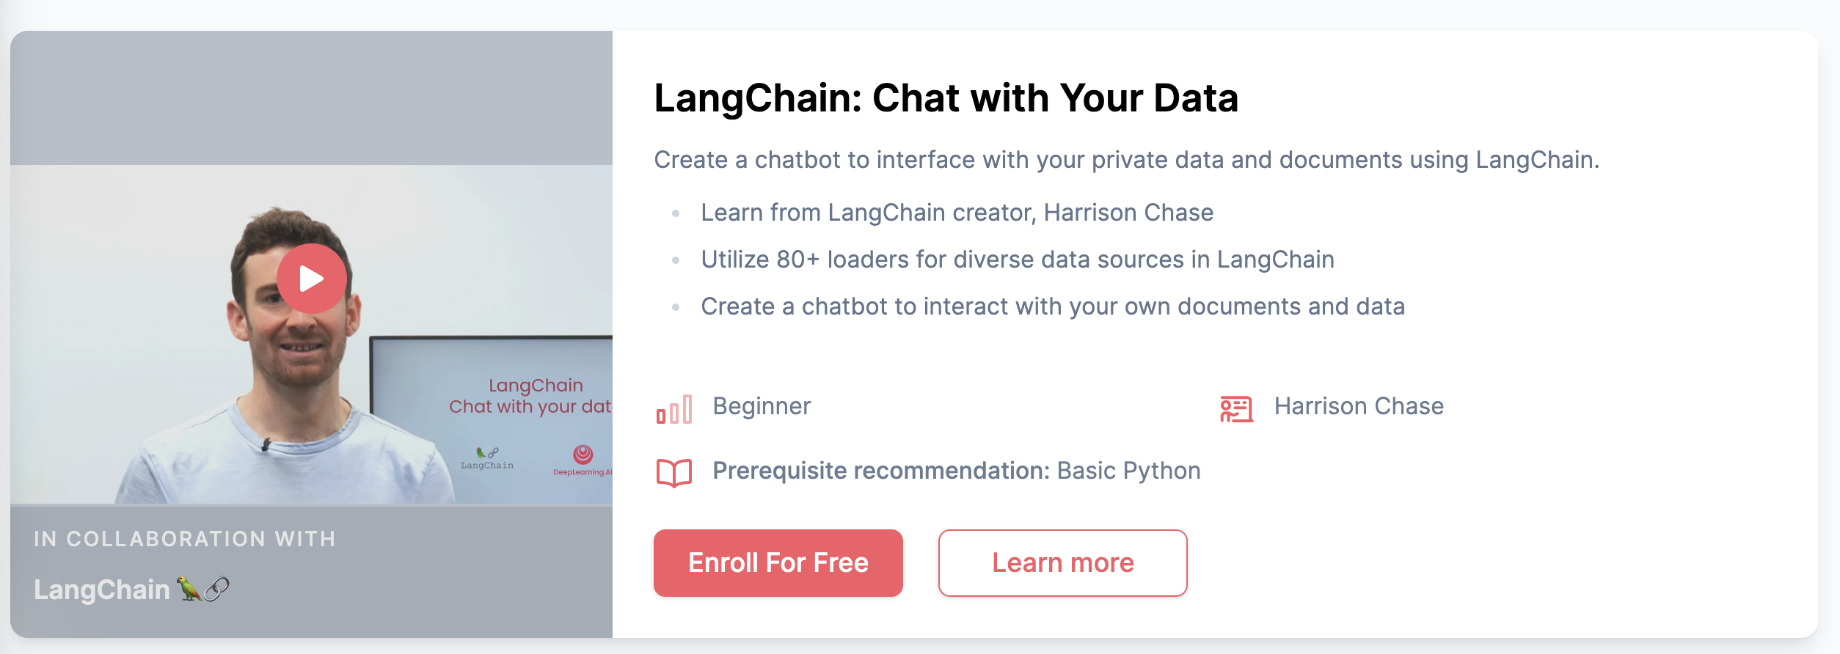
Deeplearning.ai
Free
6 h

Slide 17
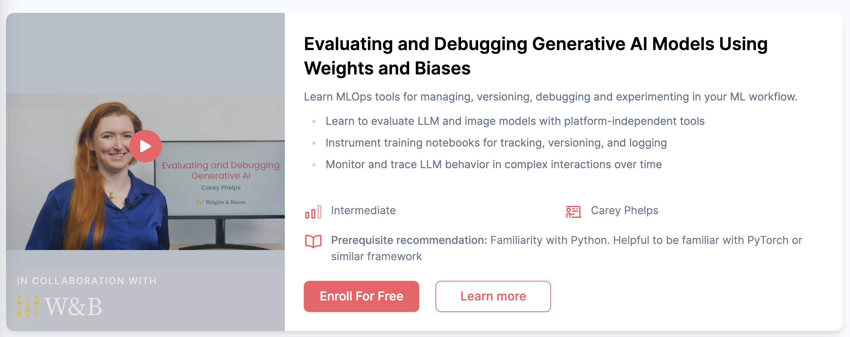
Deeplearning.ai
Free
6 h

Slide 18
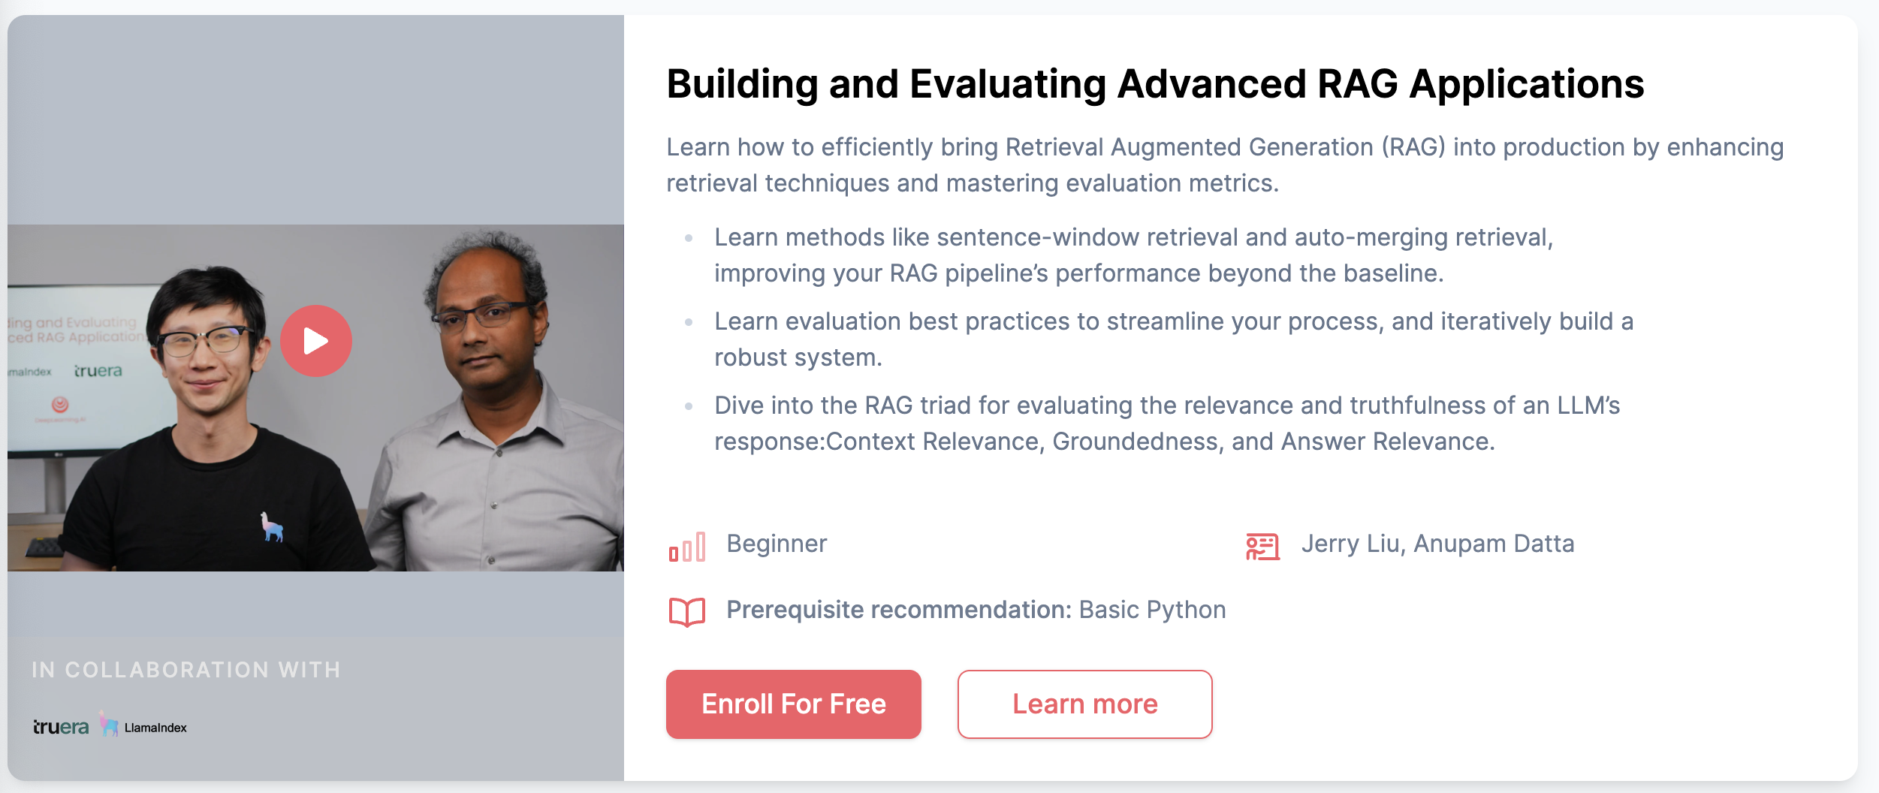
Deeplearning.ai
Free
6 h

Slide 19
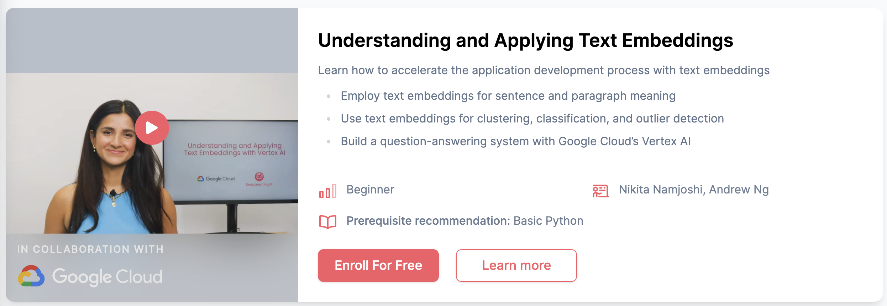
Deeplearning.ai
Free
6 h

Slide 20
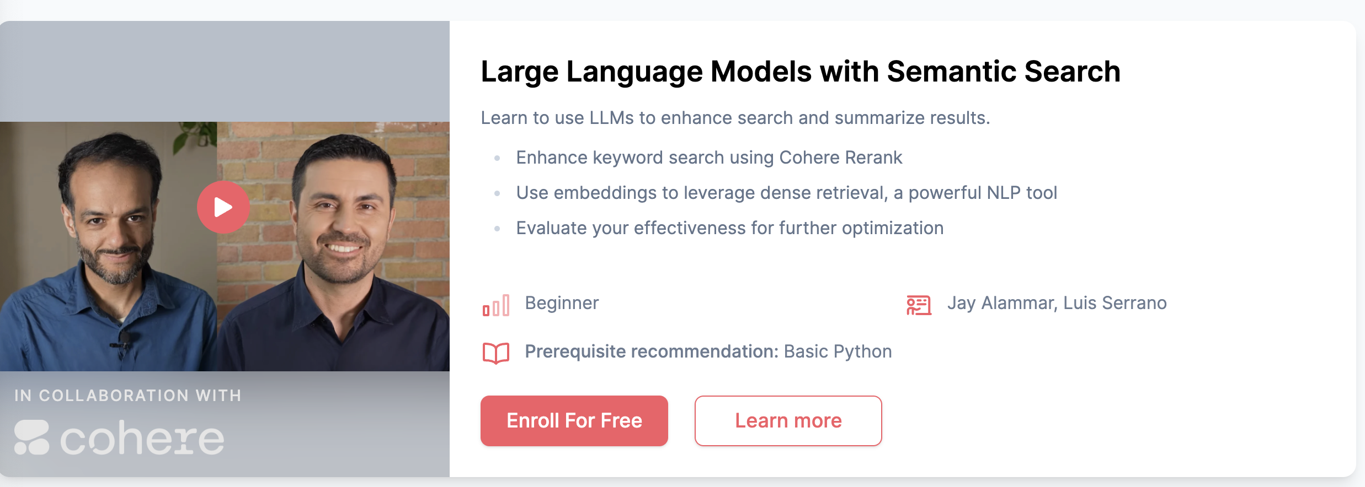
Deeplearning.ai
Free
6 h

Slide 21
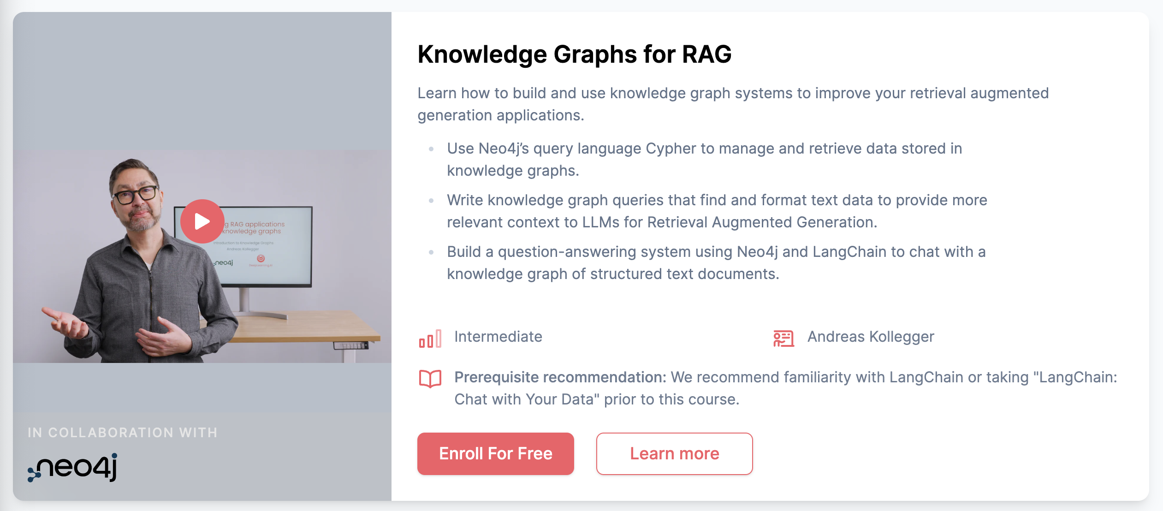
Deeplearning.ai
Free
6 h

Slide 22
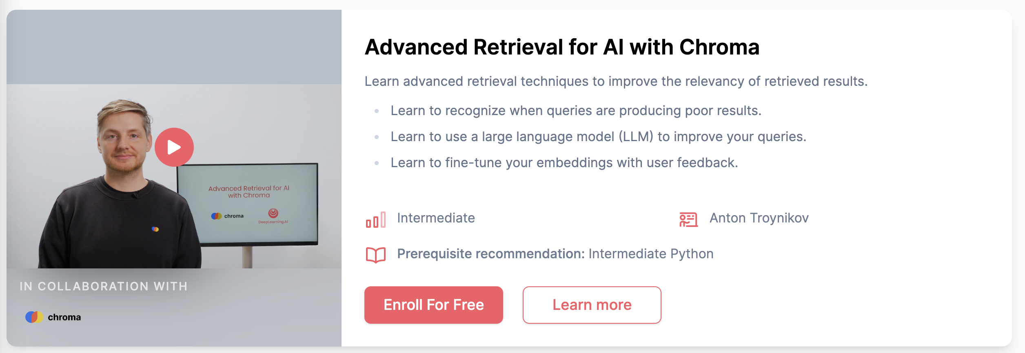
Deeplearning.ai
Free
6 h

Slide 23
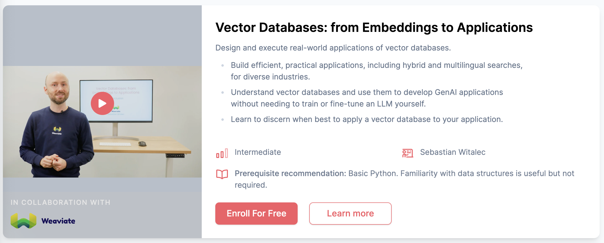
Deeplearning.ai
Free
6 h

Slide 24
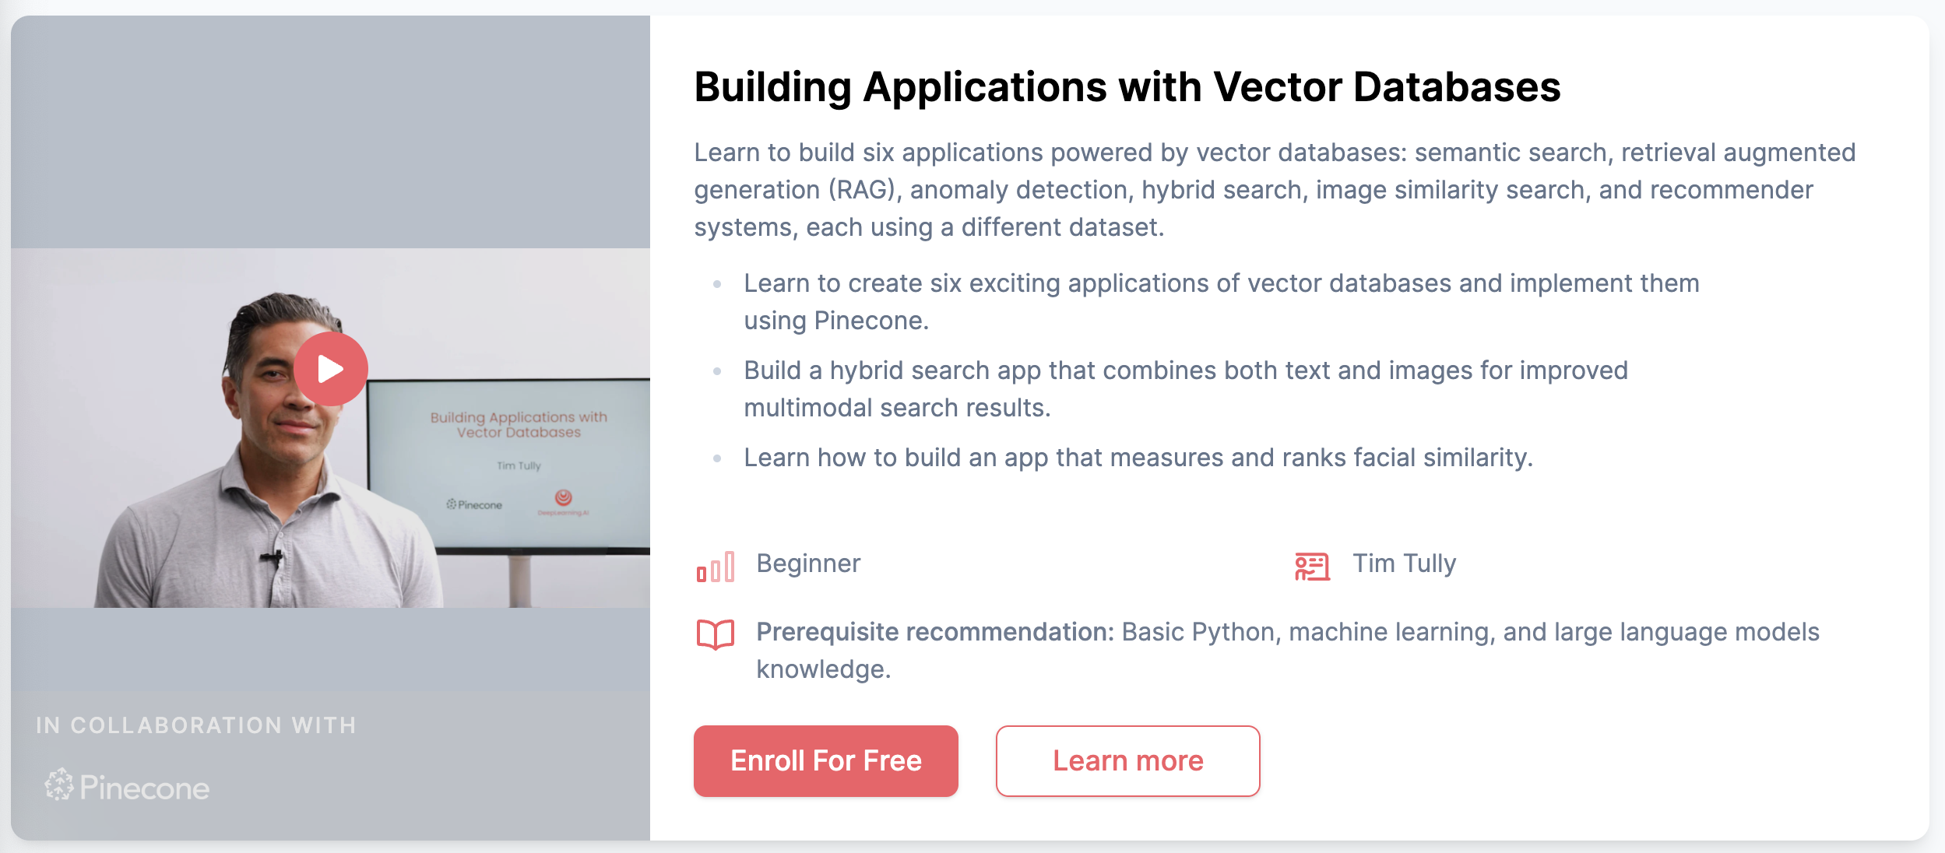
Deeplearning.ai
Free
6 h

Slide 25
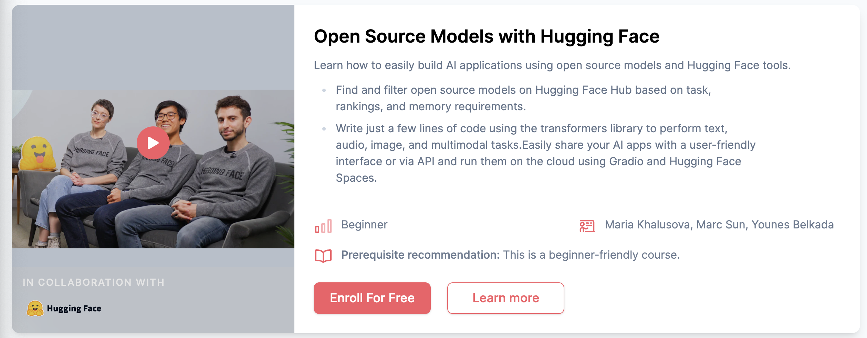
Deeplearning.ai
Free
6 h

Slide 26
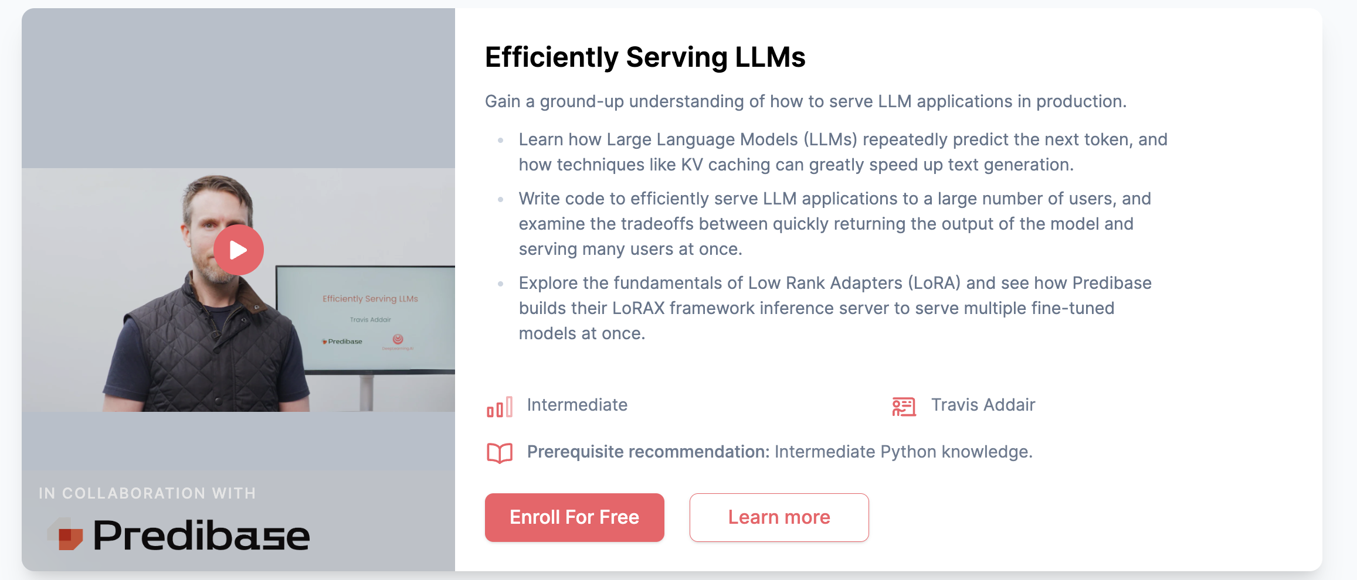
Deeplearning.ai
Free
6 h

Slide 27
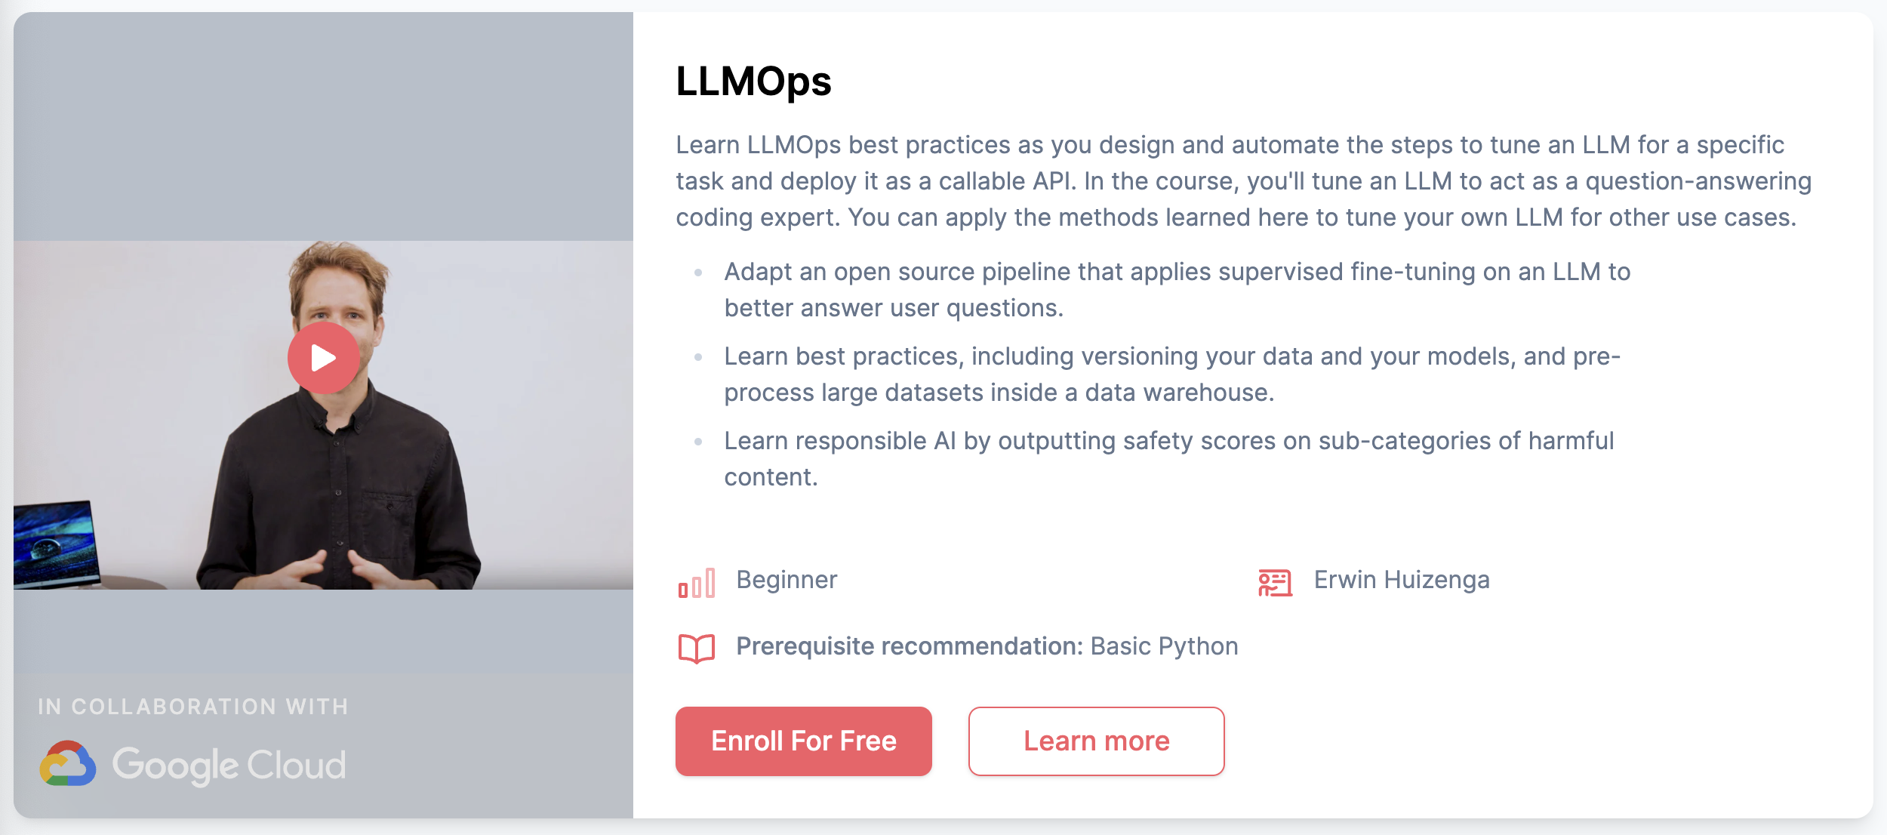
Deeplearning.ai
Free
6 h

Slide 28
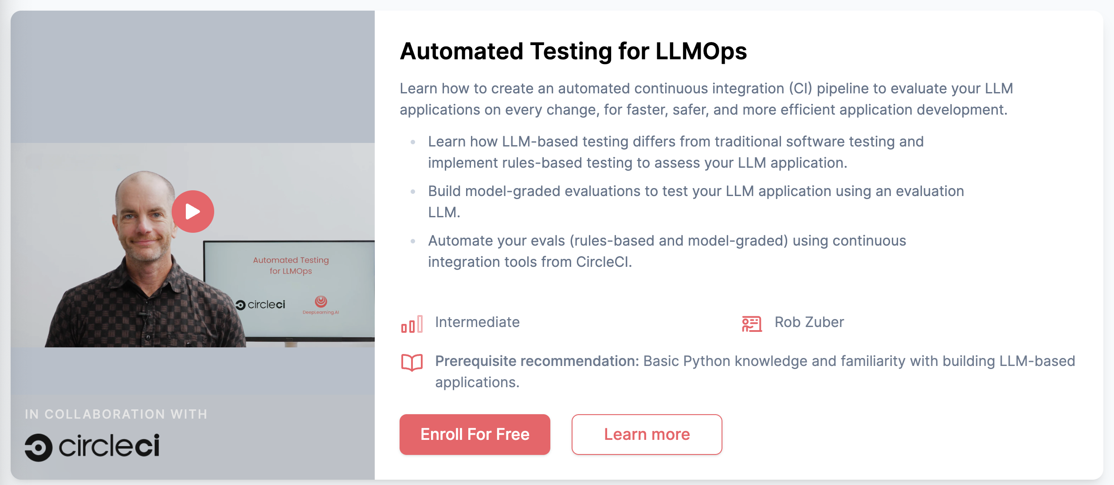
Deeplearning.ai
Free
6 h

Slide 29
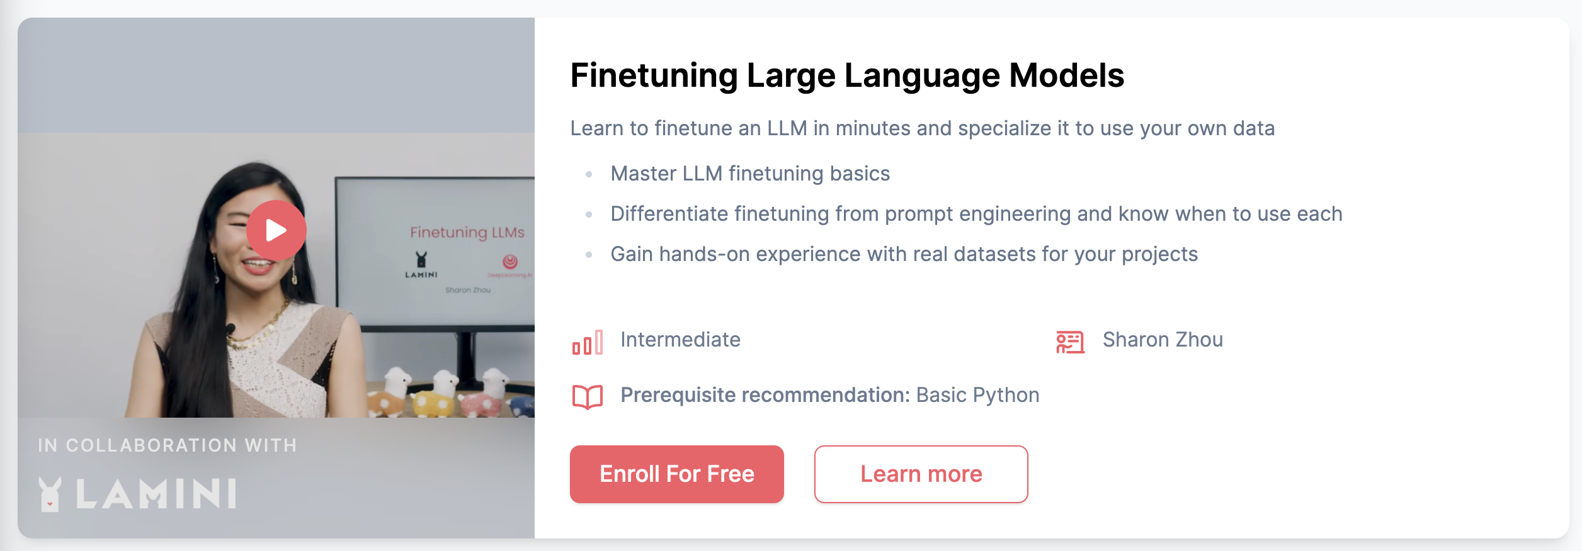
Deeplearning.ai
Free
6 h

Slide 30
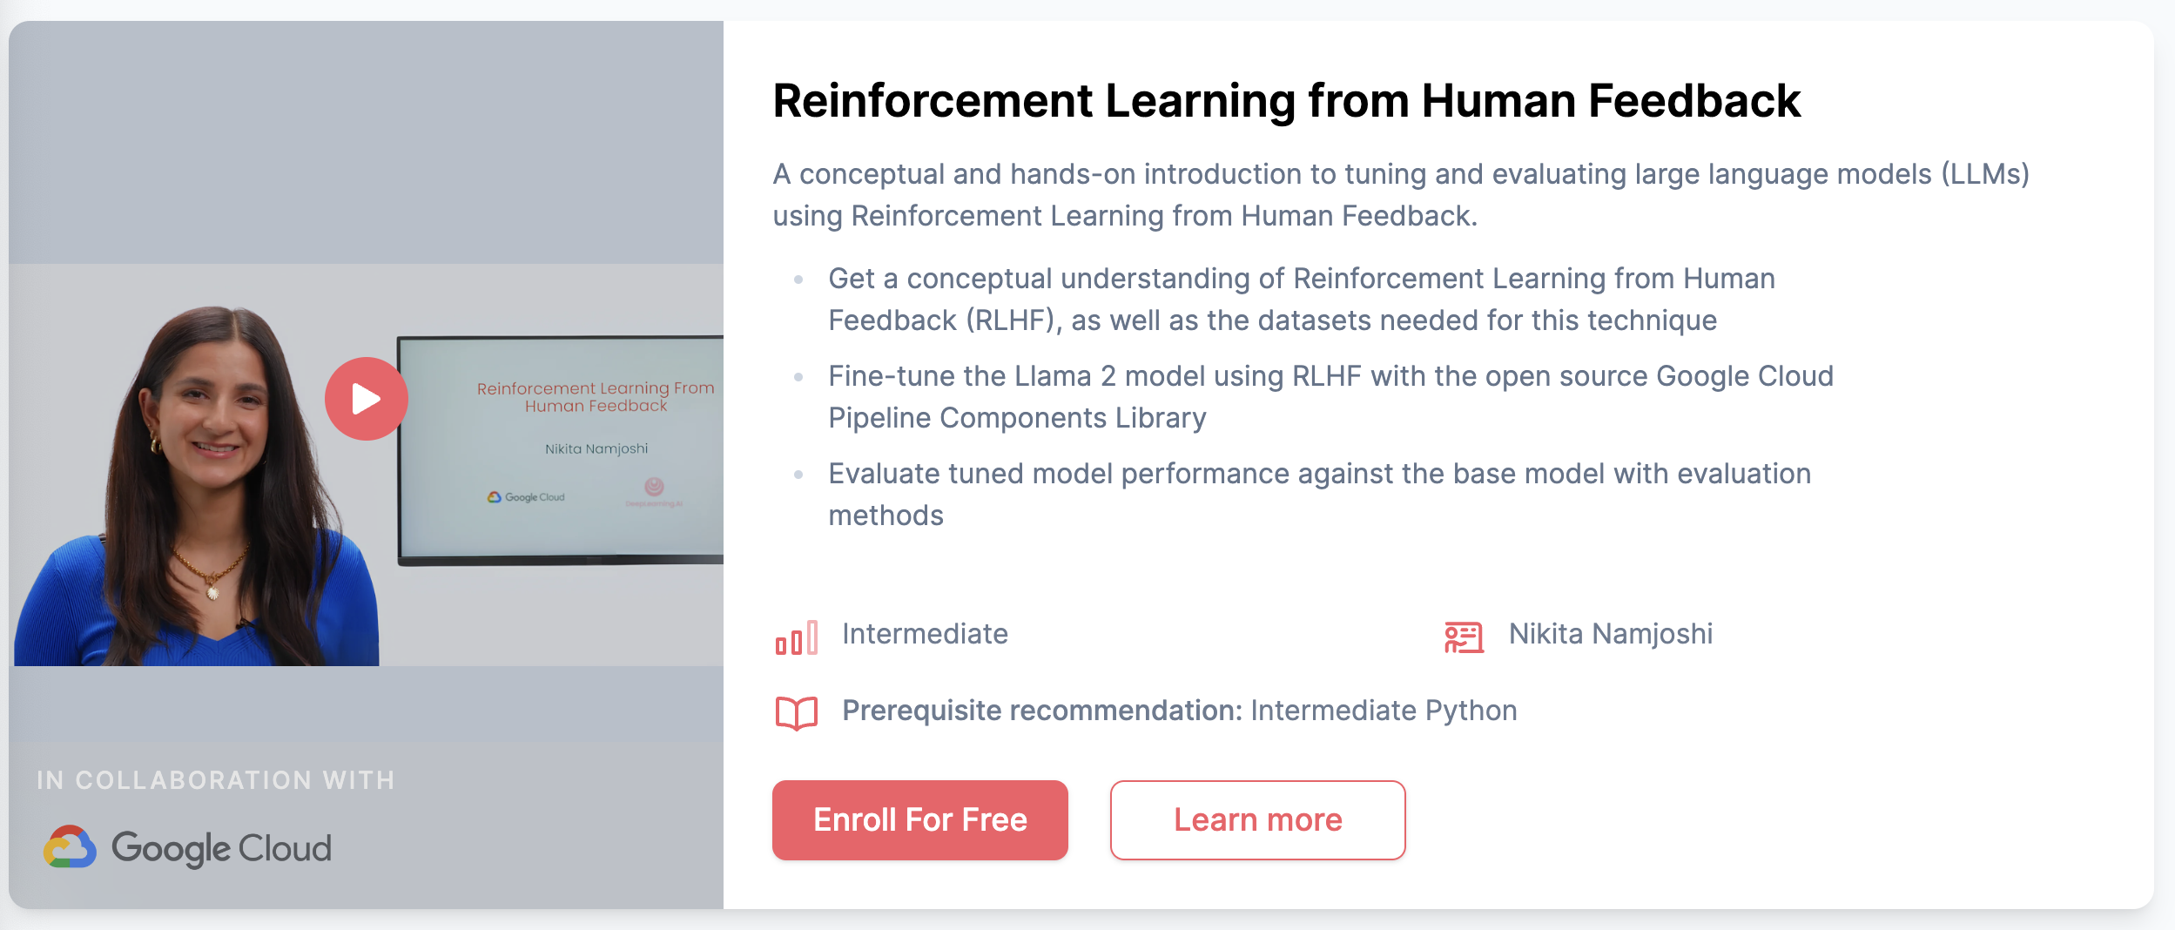
Deeplearning.ai
Free
6 h

Slide 31
Medium.com

Slide 32
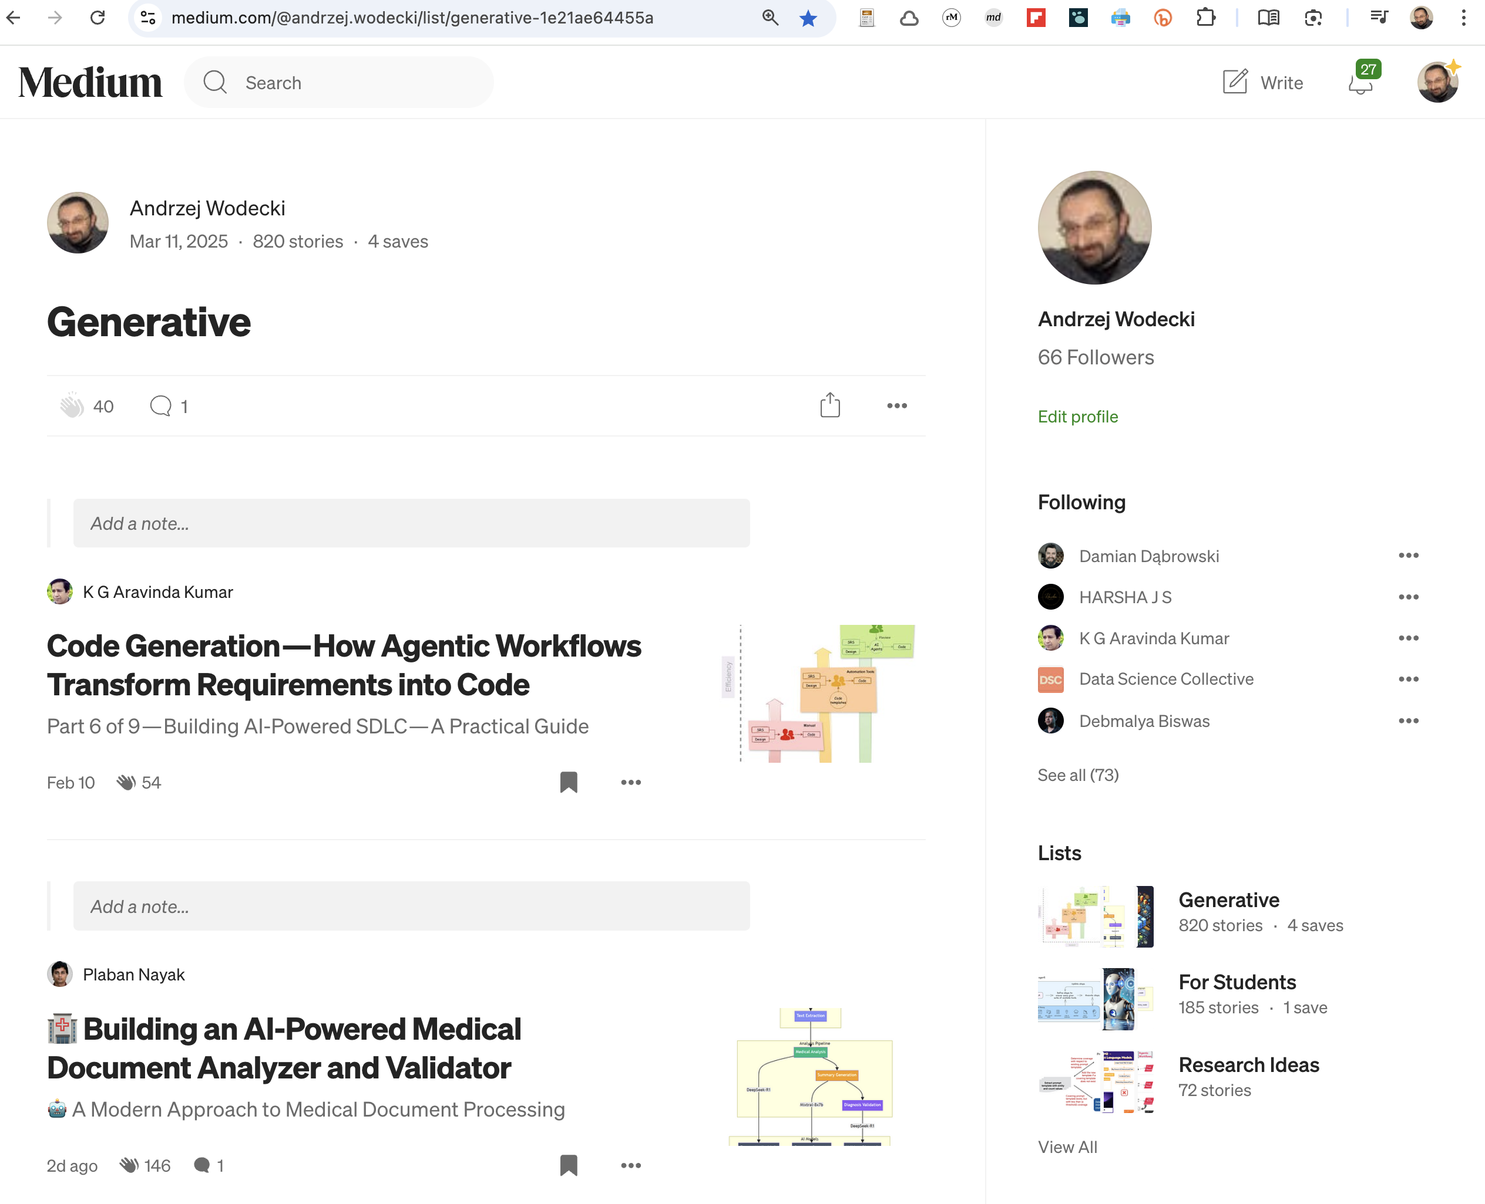
Bit.ly/generatives

